Slide 1


Chapter 1
Introduction to Entrepreneurship
Bruce R. Barringer
R. Duane Ireland
Copyright ©2012 Pearson Education, Inc. publishing as Prentice Hall
1-<number>

Slide 2
Chapter Objectives
1 of 2
Explain entrepreneurship and discuss its importance.
Describe corporate entrepreneurship and its use in established firms.
Discuss three main reasons people decide to become entrepreneurs.
Identify four main characteristics of successful entrepreneurs.
Explain five common myths regarding entrepreneurship.
Copyright ©2012 Pearson Education, Inc. publishing as Prentice Hall
1-<number>

Slide 3
Chapter Objectives
2 of 2
Explain how entrepreneurial firms differ from salary-substitute and lifestyle firms.
Discuss the changing demographics of entrepreneurs in the United States.
Discuss the impact of entrepreneurial firms on economies and societies.
Identify ways in which large firms benefit from the presence of smaller entrepreneurial firms.
Explain the entrepreneurial process.
Copyright ©2012 Pearson Education, Inc. publishing as Prentice Hall
1-<number>

Slide 4
Introduction to Entrepreneurship
According to the 2010 GEM
study, 7.6% of Americans
are actively engaged in
starting a business or are
the owner/manager of a
business that is less than
three years old.
There is tremendous interest in entrepreneurship in the U.S. and around the world.
Copyright ©2012 Pearson Education, Inc. publishing as Prentice Hall
1-<number>

Slide 5
Indications of Increased Interest in Entrepreneurship
Books
  Amazon.com lists over 35,600 books dealing with entrepreneurship and 62,700 focused on small business.
College Courses
  In 1985, there were about 250 entrepreneurship courses offered across all colleges in the United States.
  Today, more than 2,000 colleges and universities in the United States (which is about two-thirds of the total) offer at least one course in entrepreneurship.
Copyright ©2012 Pearson Education, Inc. publishing as Prentice Hall
1-<number>

Slide 6
What is Entrepreneurship?
Academic Definition (Stevenson & Jarillo)
  Entrepreneurship is the process by which individuals pursue opportunities without regard to resources they currently control.
Venture Capitalist (Fred Wilson)
  Entrepreneurship is the art of turning an idea into a business.
Explanation of What Entrepreneurs Do
  Entrepreneurs assemble and then integrate all the resources needed – the money, the people, the business model, the strategy – to transform an invention or an idea into a viable business.
Copyright ©2012 Pearson Education, Inc. publishing as Prentice Hall
1-<number>

Slide 7
Corporate Entrepreneurship
1 of 2
Corporate Entrepreneurship
  Is the conceptualization of entrepreneurship at the firm level.
  All firms fall along a conceptual continuum that ranges from highly conservative to highly entrepreneurial.
  The position of a firm on this continuum is referred to as its entrepreneurial intensity.
Copyright ©2012 Pearson Education, Inc. publishing as Prentice Hall
1-<number>

Slide 8
Corporate Entrepreneurship
2 of 2
Entrepreneurial Firms
Conservative Firms
Proactive
Innovative
Risk taking
Take a more “wait and see”
posture
Less innovative
Risk averse
Copyright ©2012 Pearson Education, Inc. publishing as Prentice Hall
1-<number>

Slide 9

Why Become an Entrepreneur?
The three primary reasons that people become entrepreneurs and start their own firms
Desire to be their own boss
Desire to pursue their
own ideas
Financial rewards
Copyright ©2012 Pearson Education, Inc. publishing as Prentice Hall
1-<number>

Slide 10
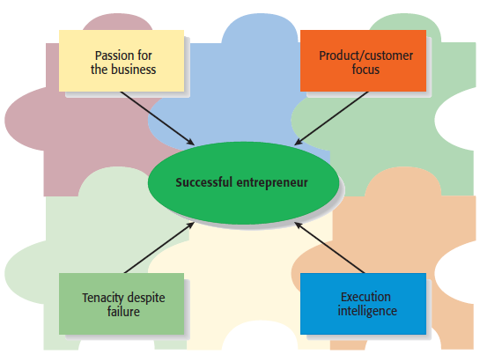
Characteristics of Successful Entrepreneurs
1 of 3
Four Primary Characteristics
Copyright ©2012 Pearson Education, Inc. publishing as Prentice Hall
1-<number>

Slide 11
Characteristics of Successful Entrepreneurs
2 of 3
Passion for the Business
  The number one characteristic shared by successful entrepreneurs is a passion for the business.
  This passion typically stems from the entrepreneur’s belief that the business will positively influence people’s lives.
Product/Customer Focus
  A second defining characteristic of successful entrepreneurs is a product/customer focus.
  An entrepreneur’s keen focus on products and customers typically stems from the fact that most entrepreneurs are, at heart, craftspeople.
Copyright ©2012 Pearson Education, Inc. publishing as Prentice Hall
1-<number>

Slide 12
Characteristics of Successful Entrepreneurs
3 of 3
Tenacity Despite Failure
  Because entrepreneurs are typically trying something new, the failure rate is naturally high.
  A defining characteristic for successful entrepreneurs is their ability to persevere through setbacks and failures.
Execution Intelligence
  The ability to fashion a solid business idea into a viable business is a key characteristic of successful entrepreneurs.
Copyright ©2012 Pearson Education, Inc. publishing as Prentice Hall
1-<number>

Slide 13
Common Myths About Entrepreneurs
1 of 5
Myth 1: Entrepreneurs Are Born, Not Made
  This myth is based on the mistaken belief that some people are genetically predisposed to be entrepreneurs.
  The consensus of many studies is that no one is “born” to be an entrepreneur; everyone has the potential to become one.
  Whether someone does or doesn’t become an entrepreneur is a function of their environment, life experiences, and personal choices.
Copyright ©2012 Pearson Education, Inc. publishing as Prentice Hall
1-<number>

Slide 14
Common Myths About Entrepreneurs
2 of 5
Although no one is “born” to be an entrepreneur, there are common traits and characteristics of successful entrepreneurs
A moderate risk taker
A networker
Achievement motivated
Alert to opportunities
Creative
Decisive
Energetic
Has a strong work ethic
Lengthy attention span
Optimistic disposition
Persuasive
Promoter
Resource assembler/leverager
Self-confident
Self-starter
Tenacious
Tolerant of ambiguity
Visionary
Copyright ©2012 Pearson Education, Inc. publishing as Prentice Hall
1-<number>

Slide 15
Common Myths About Entrepreneurs
3 of 5
Myth 2: Entrepreneurs Are Gamblers
  Most entrepreneurs are moderate risk takers.
  The idea that entrepreneurs are gamblers originates from two sources:
    Entrepreneurs typically have jobs that are less structured, and so they face a more uncertain set of possibilities than people in traditional jobs.
    Many entrepreneurs have a strong need to achieve and set challenging goals, a behavior that is often equated with risk taking.
Copyright ©2012 Pearson Education, Inc. publishing as Prentice Hall
1-<number>

Slide 16
Common Myths About Entrepreneurs
4 of 5
Myth 3: Entrepreneurs Are Motivated Primarily by Money
  While it is naïve to think that entrepreneurs don’t seek financial rewards, money is rarely the reason entrepreneurs start new firms.
  In fact, some entrepreneurs warn that the pursuit of money can be distracting.
Copyright ©2012 Pearson Education, Inc. publishing as Prentice Hall
1-<number>

Slide 17
Common Myths About Entrepreneurs
5 of 5
Myth 4: Entrepreneurs Should Be Young and Energetic
  Entrepreneurial activity is fairly easily spread out over age ranges.
  While it is important to be energetic, investors often cite the strength of the entrepreneur as their most important criteria in making investment decisions.
    What makes an entrepreneur “strong” in the eyes of an investor is experience, maturity, a solid reputation, and a track record of success.
    These criteria favor older rather than younger entrepreneurs.
Copyright ©2012 Pearson Education, Inc. publishing as Prentice Hall
1-<number>

Slide 18
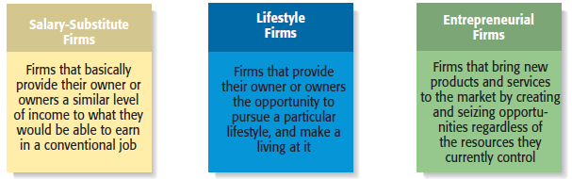
Types of Start-Up Firms
Copyright ©2012 Pearson Education, Inc. publishing as Prentice Hall
1-<number>

Slide 19
Changing Demographics of Entrepreneurs
1 of 3
Women Entrepreneurs
There were 6.2 million women-
owned businesses in 2002 (the
most recent statistics available)
This number was up 20% from
1997.
There are a growing number of
organizations that support and
advocate for women-owned
businesses.
Copyright ©2012 Pearson Education, Inc. publishing as Prentice Hall
1-<number>

Slide 20
Changing Demographics of Entrepreneurs
2 of 3
Minority Entrepreneurs
Senior Entrepreneurs
There has been a substantial
increase in minority
entrepreneurs in the U.S. from
1996 to 2010.
The biggest jump has come in
Latino entrepreneurs, which
increased from 11% to 23%
from 1996 to 2010.
The percentage of U.S.
entrepreneurs who are seniors
jumped from 15% to 23% from
1996 to 2010.
The increase is attributed to
corporate downsizing, a desire
among older workers for more
fulfillment in their lives, a need
for additional income, and
similar factors.
Copyright ©2012 Pearson Education, Inc. publishing as Prentice Hall
1-<number>

Slide 21
Changing Demographics of Entrepreneurs
3 of 3
Young Entrepreneurs
Interest among young people in entrepreneurial careers
is high.
According to a Harris Interactive survey, 40% of people eight
to 21 years old said they’d like to start their own business
someday.
A total of 59% of the 8- to 21- year olds said they know
someone who has started their own business.
Copyright ©2012 Pearson Education, Inc. publishing as Prentice Hall
1-<number>

Slide 22
Economic Impact of Entrepreneurial Firms
Innovation
  Is the process of creating something new, which is central to the entrepreneurial process.
  Several studies have found that small businesses outperform
  their larger counterparts in terms of obtaining patents.
Job Creation
  Small businesses are the creators of most new jobs in the U.S., and employ half of all private sector employees.
  According to a Kauffman Foundation survey, 92% of Americans say entrepreneurs are critically important to job creation.
Copyright ©2012 Pearson Education, Inc. publishing as Prentice Hall
1-<number>

Slide 23
Entrepreneurial Firms’ Impact on Society and Larger Firms
Impact on Society
  The innovations of entrepreneurial firms have a dramatic impact on society.
  Think of all the new products and services that make our lives easier, enhance our productivity at work, improve our health, and entertain us in new ways.
Impact on Larger Firms
  Many entrepreneurial firms have built their entire business models around producing products and services that help larger firms become more efficient and effective.
Copyright ©2012 Pearson Education, Inc. publishing as Prentice Hall
1-<number>

Slide 24
The Entrepreneurial Process
The Entrepreneurial Process Consists of Four Steps
Step 1: Deciding to become an entrepreneur.
Step 2: Developing successful business ideas.
Step 3: Moving from an idea to an entrepreneurial firm.
Step 4: Managing and growing the entrepreneurial firm.
Copyright ©2012 Pearson Education, Inc. publishing as Prentice Hall
1-<number>

Slide 25
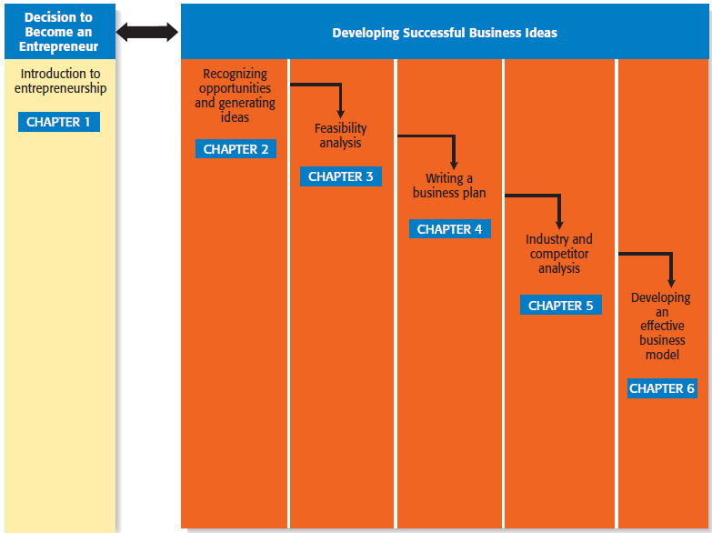
Steps in the Entrepreneurial Process
1 of 2
Step 1
Step 2
Developing Successful Business Ideas
Copyright ©2012 Pearson Education, Inc. publishing as Prentice Hall
1-<number>

Slide 26
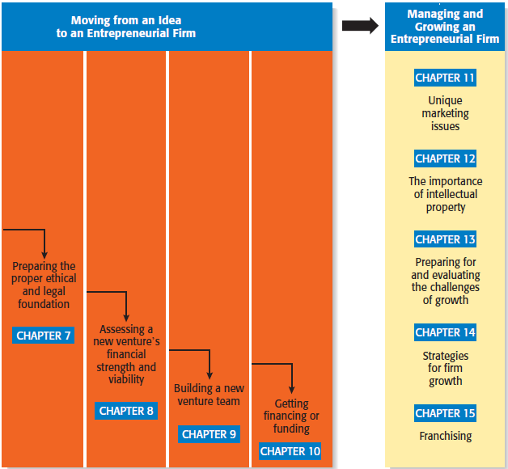
Steps in the Entrepreneurial Process
2 of 2
Step 3
Step 4
Copyright ©2012 Pearson Education, Inc. publishing as Prentice Hall
1-<number>

Slide 27

All rights reserved. No part of this publication may be reproduced, stored in a retrieval system, or transmitted, in any form or by any means, electronic, mechanical, photocopying, recording, or otherwise, without the prior written permission of the publisher. Printed in the United States of America.
Copyright ©2012 Pearson Education, Inc. publishing as Prentice Hall
Copyright ©2012 Pearson Education, Inc. publishing as Prentice Hall
1-<number>

